Slide 1
Performance
Advanced Android Development
Lesson 4

Slide 2

4.2 Memory

Slide 3
Contents
Basics of memory in Android
Garbage collection
Memory leaks and churn
Memory Profiler tool
Dump Java heap
Record memory allocations

Slide 4
Basics of memory in Android

Slide 5
Memory
All processes, services, and apps require memory to store instructions and data
Running app allocates memory for objects and processes in its assigned memory heap
Memory allocation—the process of reserving memory for your app objects and processes

Slide 6
Android manages memory environment
You don't have to manually manage memory, the system does it for you
Android team has put a lot of work into making memory management as fast and efficient as possible

Slide 7
Android manages memory for you, but...
If your code is memory inefficient, Android's management is not going to help
Cleaning up memory resources also takes time, which hurts performance

Slide 8
Referenced objects stay in memory
Android runtime (ART) (5.0/API 21) and Dalvik virtual machine use paging and memory-mapping
Memory that an app modifies stays in RAM
Release object references to make memory available for reclamation (garbage collection)
Learn more: ART and Dalvik, Memory Management in Java

Slide 9
Garbage collection

Slide 10
Garbage collection
Garbage collection (GC) is the automatic process of freeing up space in a computer's memory by removing data that is no longer required or in use
Finds data objects that cannot be accessed in the future because they are no longer referenced
Reclaims resources used by those objects

Slide 11
Frequent GC hurts performance
You cannot control garbage collection (you can force it, but not control what it does or how it does it)
Code flow affects conditions that trigger GC
Heap size is limited ⇒ OutOfMemoryError
For example, if you allocate and keep references to multiple objects in the innermost part of a loop

Slide 12
Memory leaks and churn

Slide 13
Memory leak
Code allocates memory for many objects and never releases references / never frees memory
Less and less memory available ⇒ app slows down
No more memory ⇒ app crashes

Slide 14
Memory churn
When app is low on memory...
...garbage collection events increase...
...which takes more and more time
App slows down

Slide 15
Don't leak View objects
Do not reference View objects
from outside the UI thread
in async callbacks
from static objects
More in Do Not Leak Views video

Slide 16
Avoid looping allocations
Do not allocate objects in inner loops
Do it outside the loop
Redesign to avoid allocation

Slide 17
Avoid allocations in onDraw() method
Called 60 times per second!
Do not create new objects in onDraw()
For example, create one object in onCreate() and reuse
For example, use object pools—allocate group of objects and reuse

Slide 18
Memory Profiler tool

Slide 19
With the Memory Profiler you can...
View real-time count of allocated objects and garbage collection events on timeline
Dump the Java heap to see which objects are using up memory at any given time
Record memory allocations to see where your code is allocating too many objects, or large objects

Slide 20
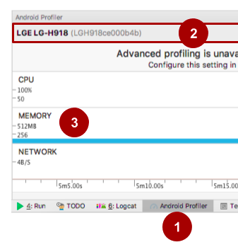
Starting Memory Profiler
Make sure developer options are enabled on the device
In Android Studio:
Open Android Profiler (1)
Select device and app (2)
MEMORY graph starts (3)

Slide 21
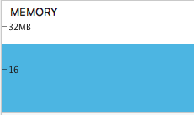
Initial graph shows total memory
Total memory used over time
Click to expand for details

Slide 22
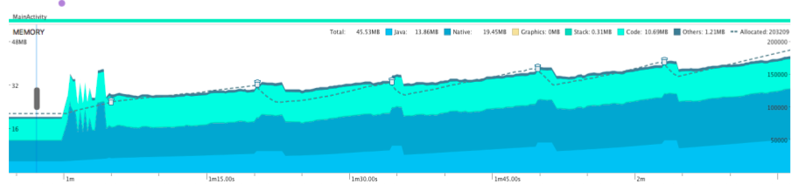
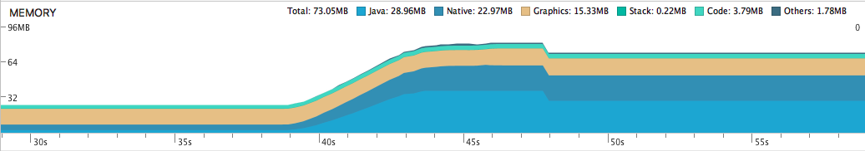
Expanded memory graphs
Stacked graph for types of memory
Trash cans show GC events

Slide 23
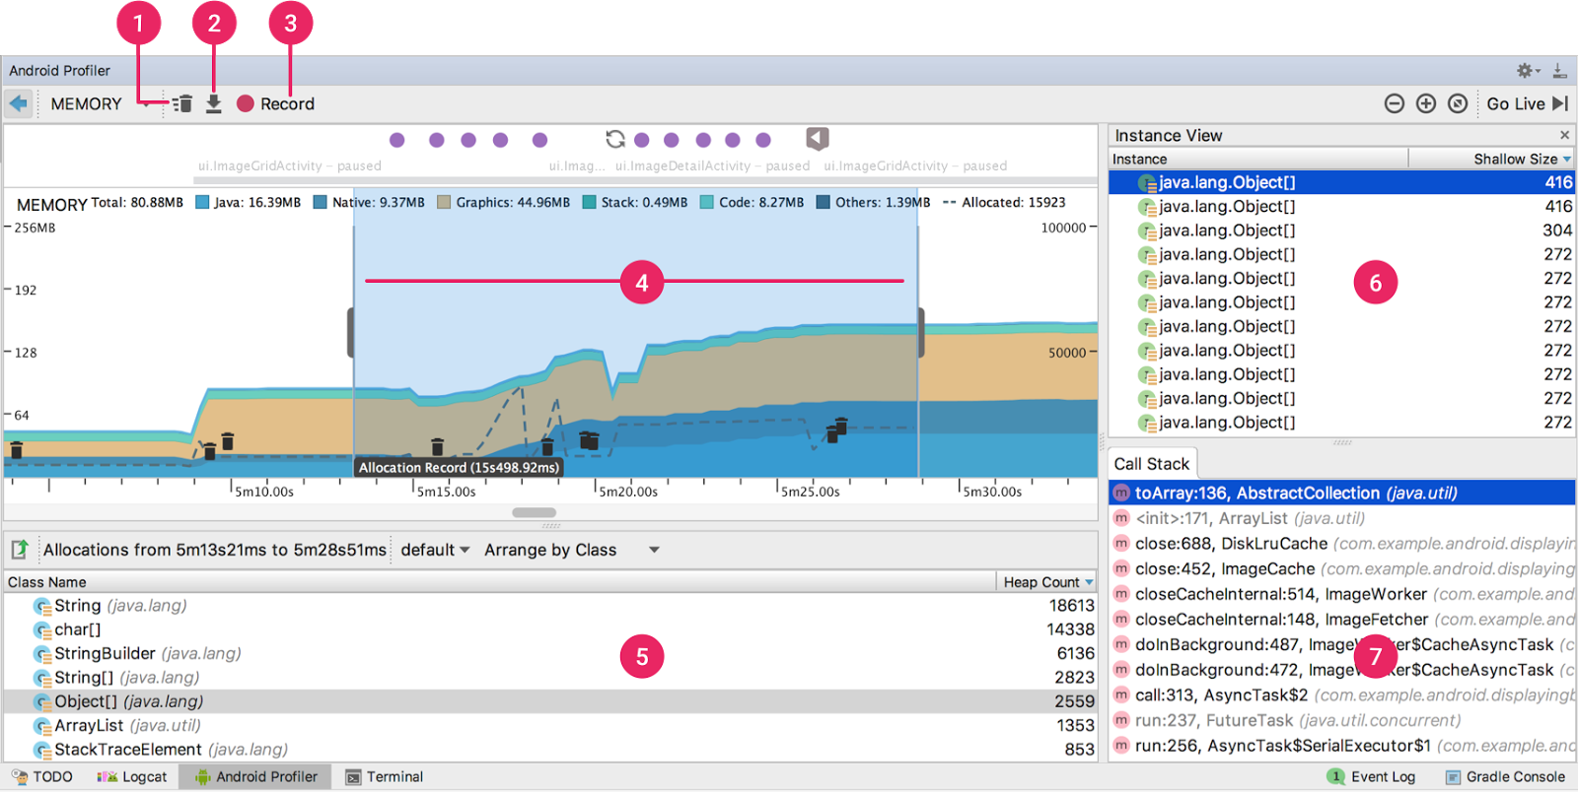
Starting tools
(1) Force garbage collection
(2) Capture a heap dump and display its contents
(3) Record memory allocations and display the recorded data

Slide 24
Recording
(4) Highlighted portion recorded
Purple dots are user actions
(5) Allocation recording and heap dump results below timeline

Slide 25
Viewing details
(6) Select class name to see instances
(7) Click instance to show either
stack trace for memory allocated (allocation recording), or
remaining references to object (heap dump)

Slide 26
Dump Java heap

Slide 27
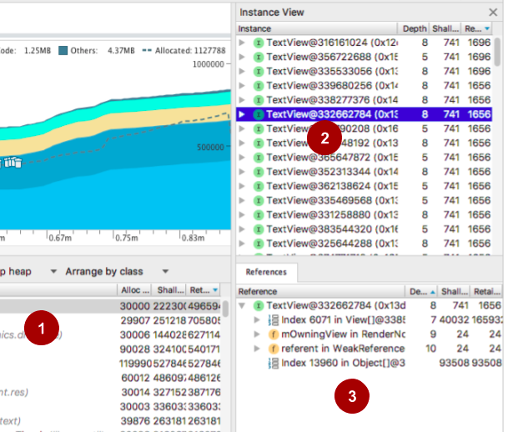

Dump Java heap
In detail graph view, click Dump Java Heap button
To inspect dumped heap:
Click class name (1) then instance (2) to see details in Reference pane (3)

Slide 28
Record memory allocations

Slide 29

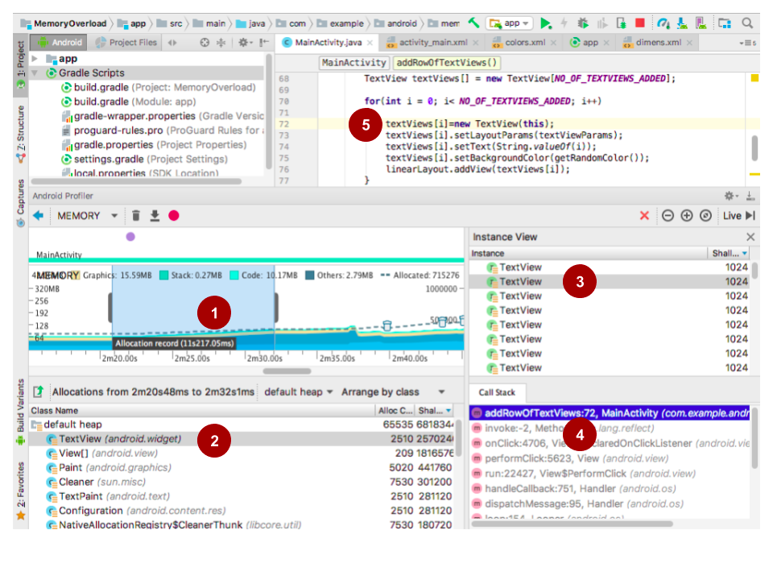
Record allocations
In detail graph view, click Record Memory Allocations
Click Stop Recording
Graph shows recorded portion (1) and Class Name list (2)

Slide 30
Find allocations in code
Click instance (3)
Click method in Call Stack (4)
Examine code (5)

Slide 31
What's next?
Concept chapter: 4.2 Memory
Practical: 4.2 Using the Memory Profiler tool

Slide 32
END

